Slide 2
DAY #1
XCODE
BASIC UI
Hello World
Run/Debug on Simulator
Some common Settings in XCode
Profiles
XIB vs Storyboard
Control Library
Inspector: Identity, Attribute, Size, Connections
Custom Control

Slide 3
XCode
Hello World
Run/Debug on Simulator
Some common Settings in XCode
Profiles

Slide 4
XCode – Hello World
Target: Module độc lập được link trong project.
Playground: Môi trường để execute các đoạn script swift.
Project: Project 👈
Package: Swift Package có thể đóng gói và phân phối bằng SPM.
Workspace: Chứa nhiều project có thể liên kết với nhau.

Slide 5
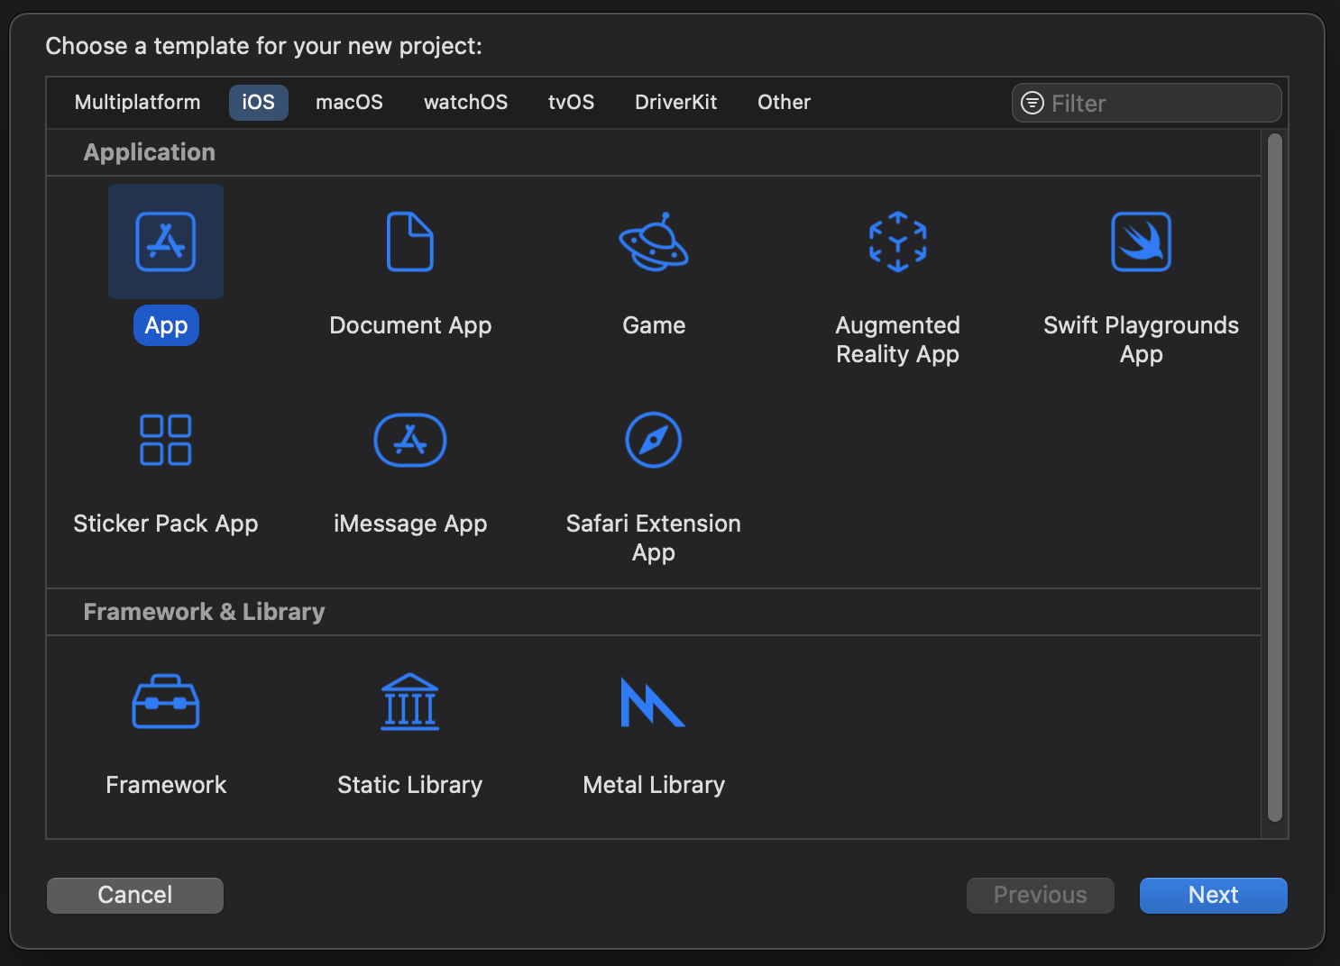
XCode – Hello World
1
Chọn platform của dự án
Template App iOS cơ bản (1 splashscreen, 1 view blank)
Dynamic Library, đóng gói trong IPA, liên kết khi runtime
Static Library, liên kết compile time.
Graphic APIs, tương tự OpenGL, DirectX,
2
3
4
5
Notes:
Static Library vs Dynamic Library in iOS | by Pratheesh Bennet | Medium

Slide 6
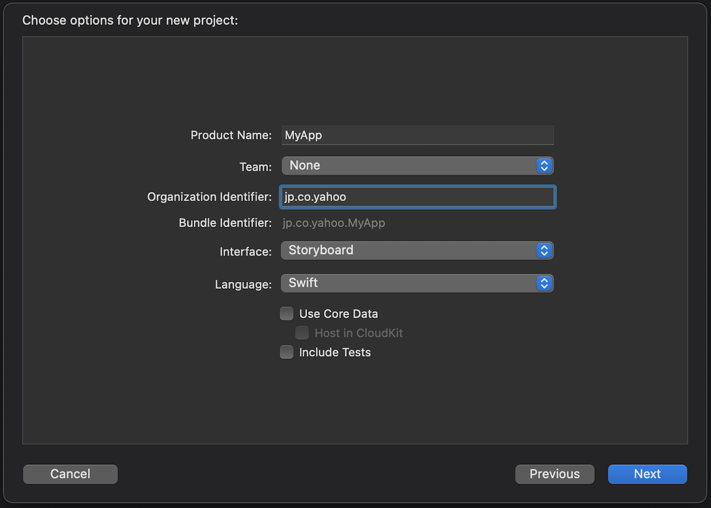
XCode – Hello World
1
2
3
4
6

Slide 7
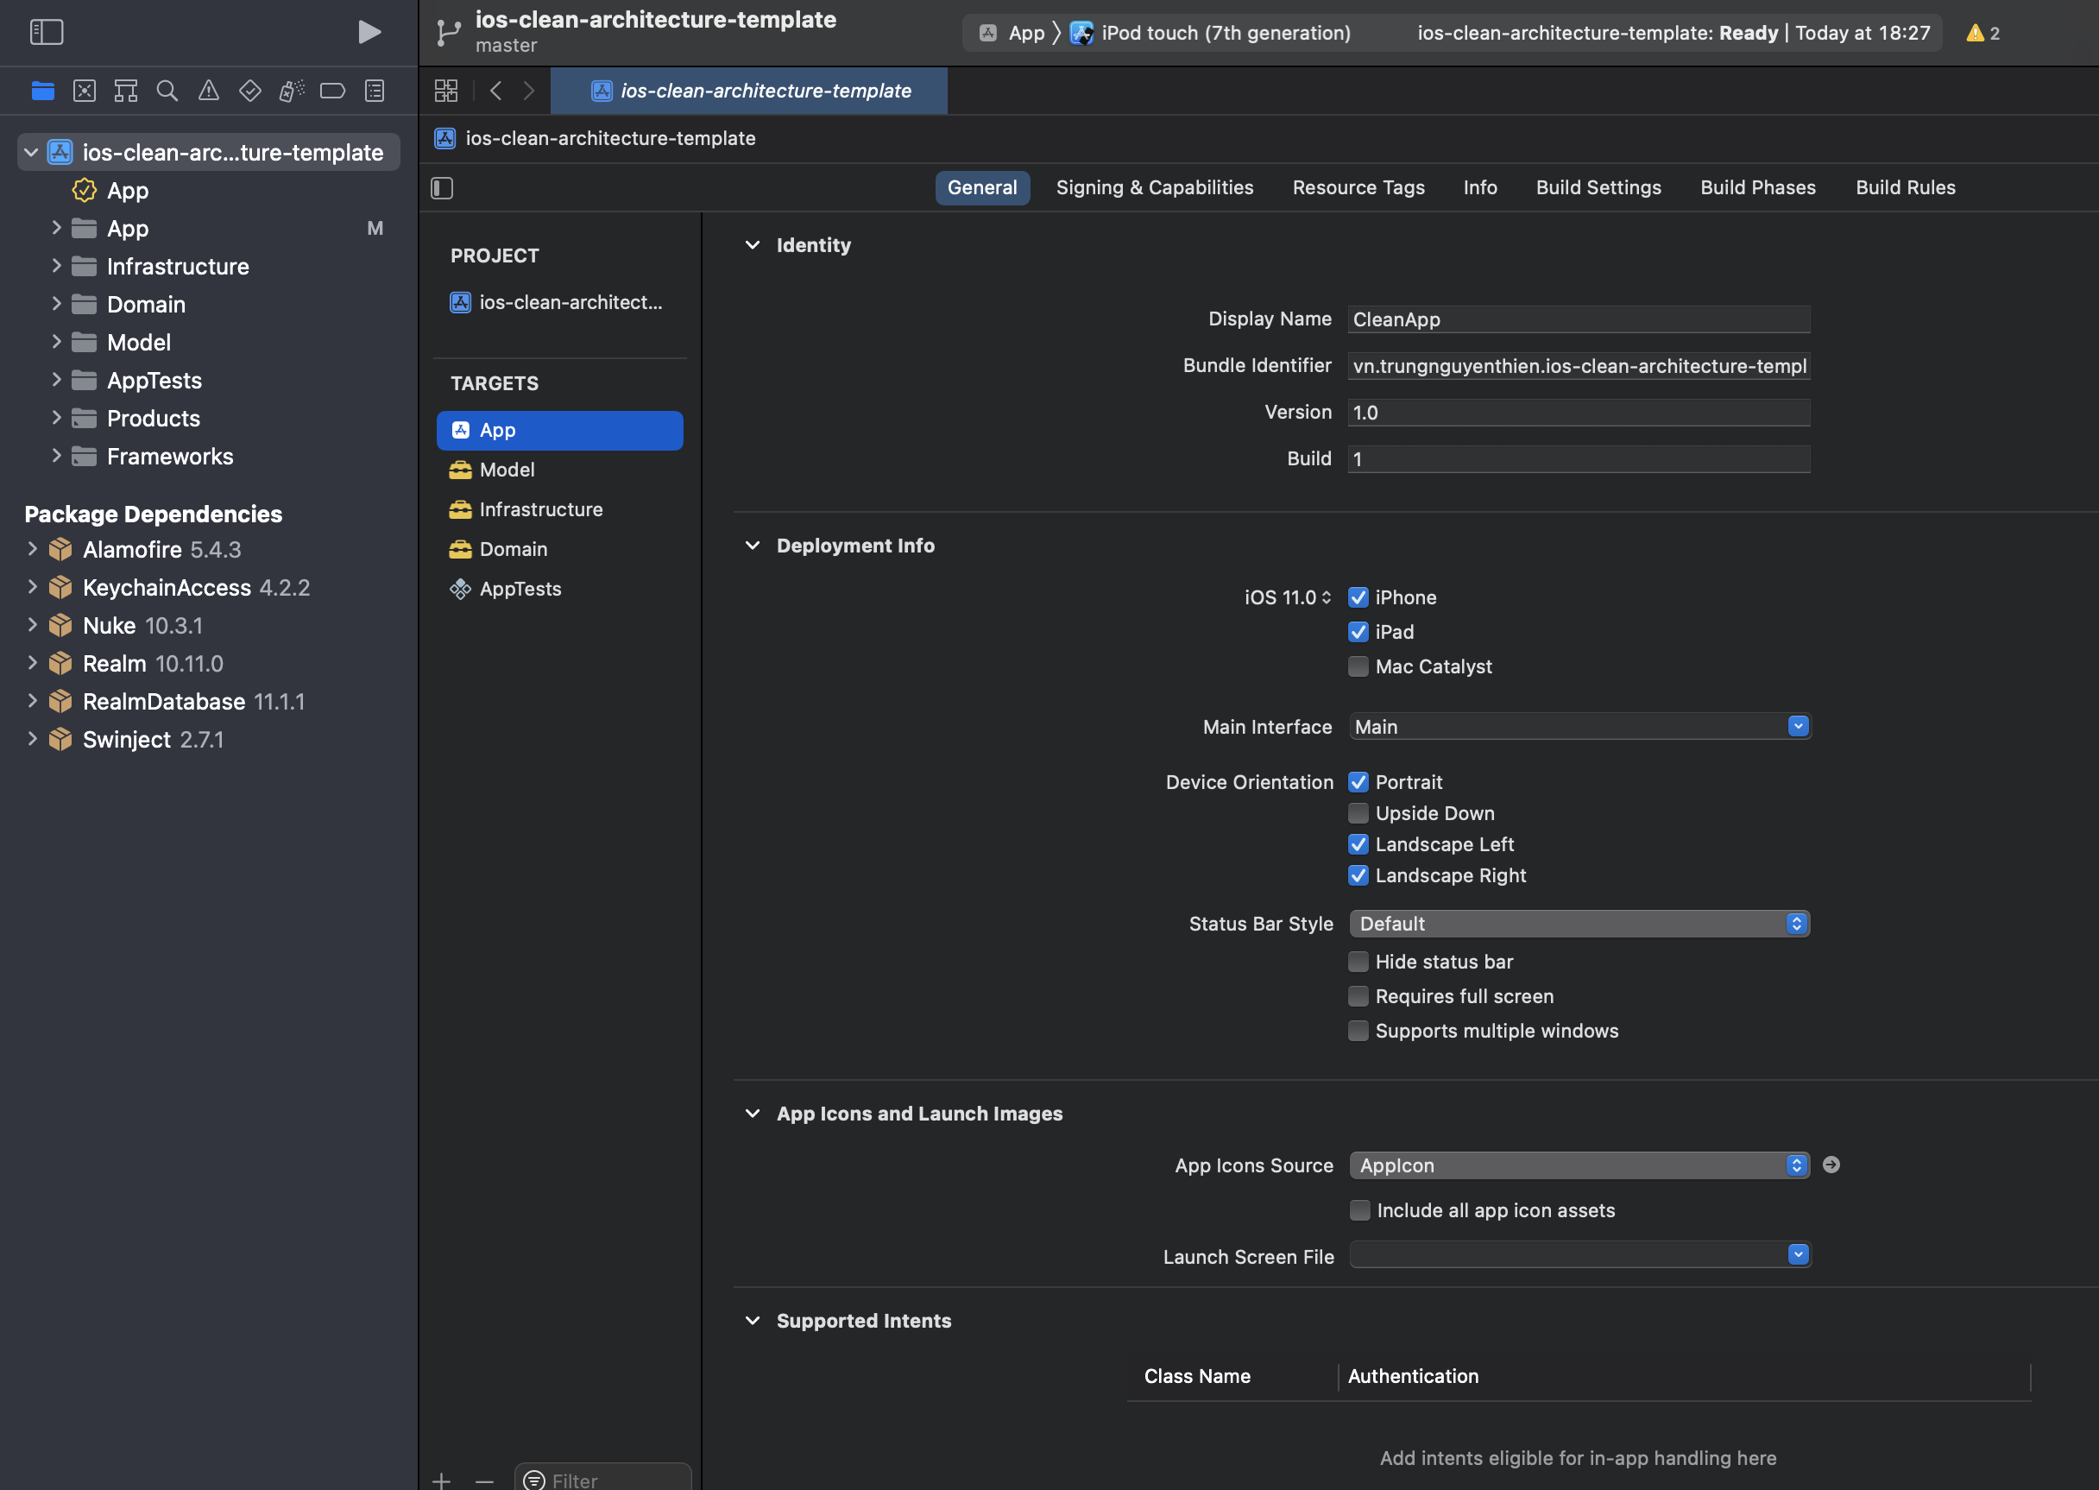
XCode Views
Deploy + Scheme + Simulator
Source & Assets
Target Setting
Targets
SPM’s Packages

Slide 8
Basic UI

Slide 9
File Templates File > New > File…
Cocoa Touch Class: Template View trong UIKit framework
SwiftUI View: Template View của SwiftUI framework
Swift File: Empty swift file
Notes:
Specifying your app’s launch screen | Apple Developer Documentation
Launch screens in Xcode: All the options explained - SwiftLee (avanderlee.com)

Slide 10
*.XIB (or NIB)
*.Storyboard
Chứa thiết kế 1 view đơn
Chứa thiết kế nhiều view, navigation giữa các screen.
Format XML phức tạp, khó resolve conflict
=> Developer thường dùng XIB để hạn chế việc giải quyết conflict code.

Slide 11
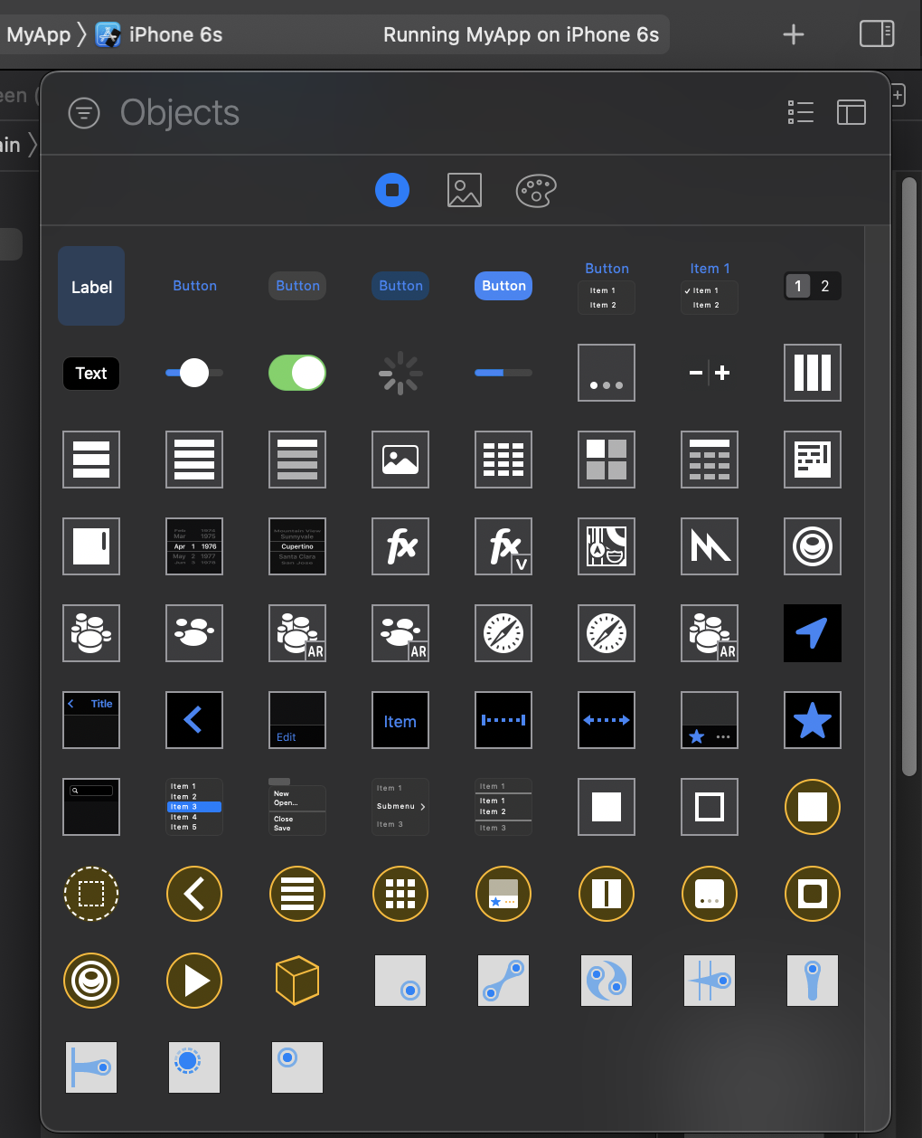
Control Library
Quite common
Very common

Slide 12
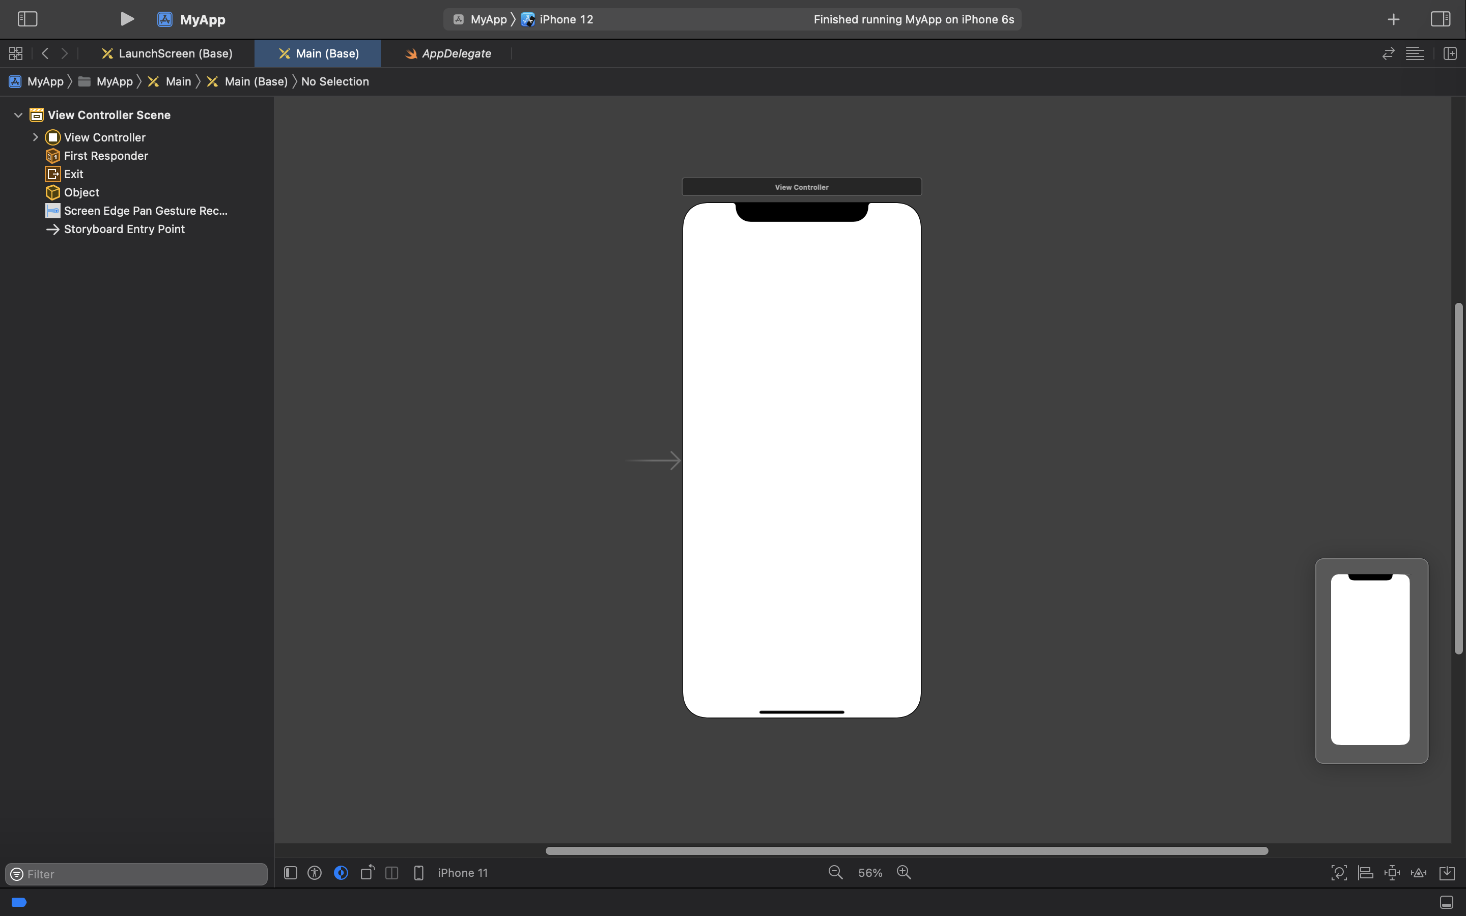

Design Mode
1
2
3
4
6
File browse
Run App
View Library
File
Commit history
Quick Help
Identity & Type
Attributes
Size
Connector
Change Size Classes
View, Constraint Structure
5

Slide 13
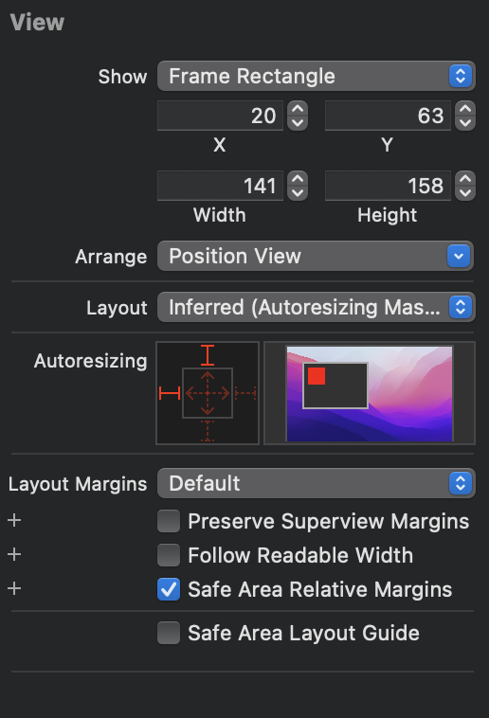
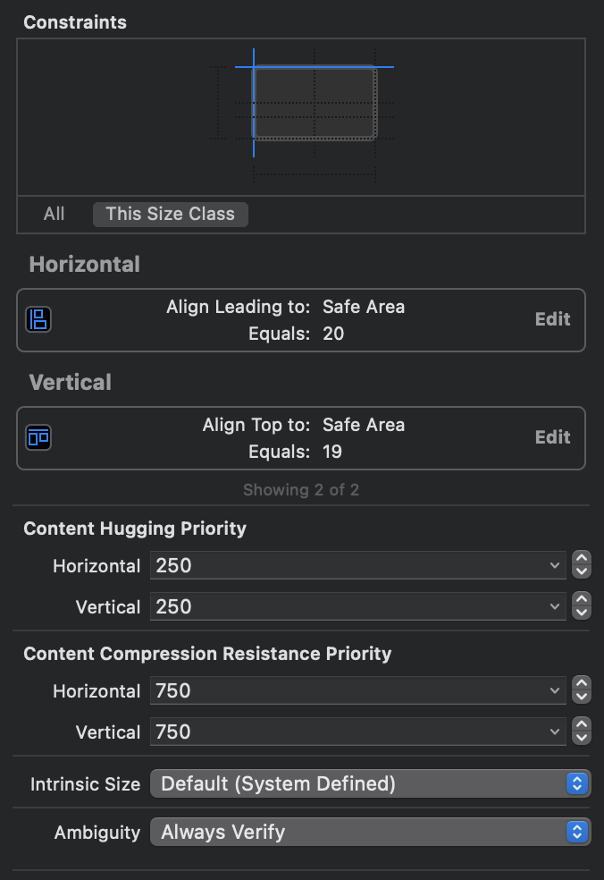
Layout View
Frame Base
Constraint Base
Performance
Easy
No crash
Multiple Size
Complex UI

Slide 14
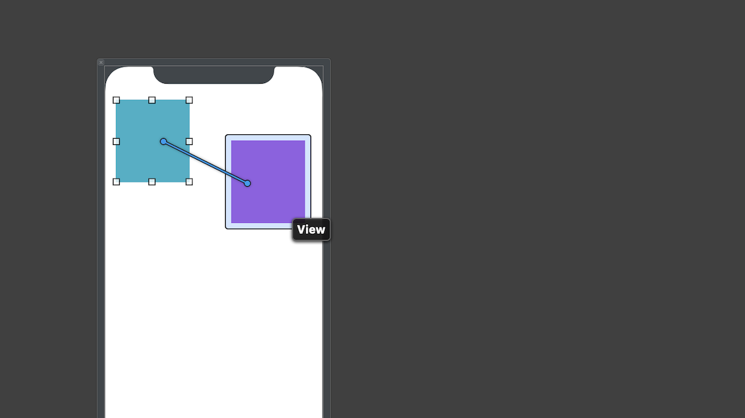
Add Constraint
First
Second
Right Drag
(*) First, Second khác nhau thì giá trị của constraint sẽ khác.

Slide 15
Constraint Type
Vertical Space (Top, Bottom Space) Horizontal Space (Leading, Trailing Space)
Align Leading Align Trailing Align Top Align Bottom
Width Height Aspect Ratio
Center Vertical Center Horizontal
W:15
W:22
w45:h27

Slide 16
@IBOutlet, @IBAction

Slide 17
Profiles
Allow you to install apps on your iOS devices or Mac.
Include signing certificates, device identifiers, and a bundle ID.

Slide 18



Provisioning Profile
Developer Certificates
App Information
Test Device UUIDs
Aさん (Development)
Bundle Identifier
com.apple.mobilesafari
Bさん (Development)
iPhone 6s
iPhone XR
iPhone 8s
😎
Cさん (Distribution)
Dさん (Development)
iPad Pro
iPad Mini 2
iPhone 13

Slide 19
Team Roles in Apple Developer Program Certificates, Identifiers & Profiles
 | Holder | Admin | Manager | Developer
Accept legal agreements, Renew membership | 🟢
Submit certificate signing requests | 🟢 | 🟢 | 🟡 | 🟡
Download provisioning profiles | 🟢 | 🟢 | 🟡 | 🟡
Create & revoke development certificates | 🟢 | 🟢 | 🟡 | 🟡
Create & delete development profiles | 🟢 | 🟢 | 🟡
Create & revoke distribution certificates | 🟢 | 🟢 | 🟡
Create & delete distribution profiles | 🟢 | 🟢 | 🟡
🟢 Full access. 🟡 Requires access to Certificates, Identifiers & Profiles, granted in Users and Access in App Store Connect. Includes access to CloudKit Console.
Notes:
Enrolling into the Apple Developer Program as an organization | WellnessLiving
Apple Developer Program Roles - Support - Apple Developer

Slide 20
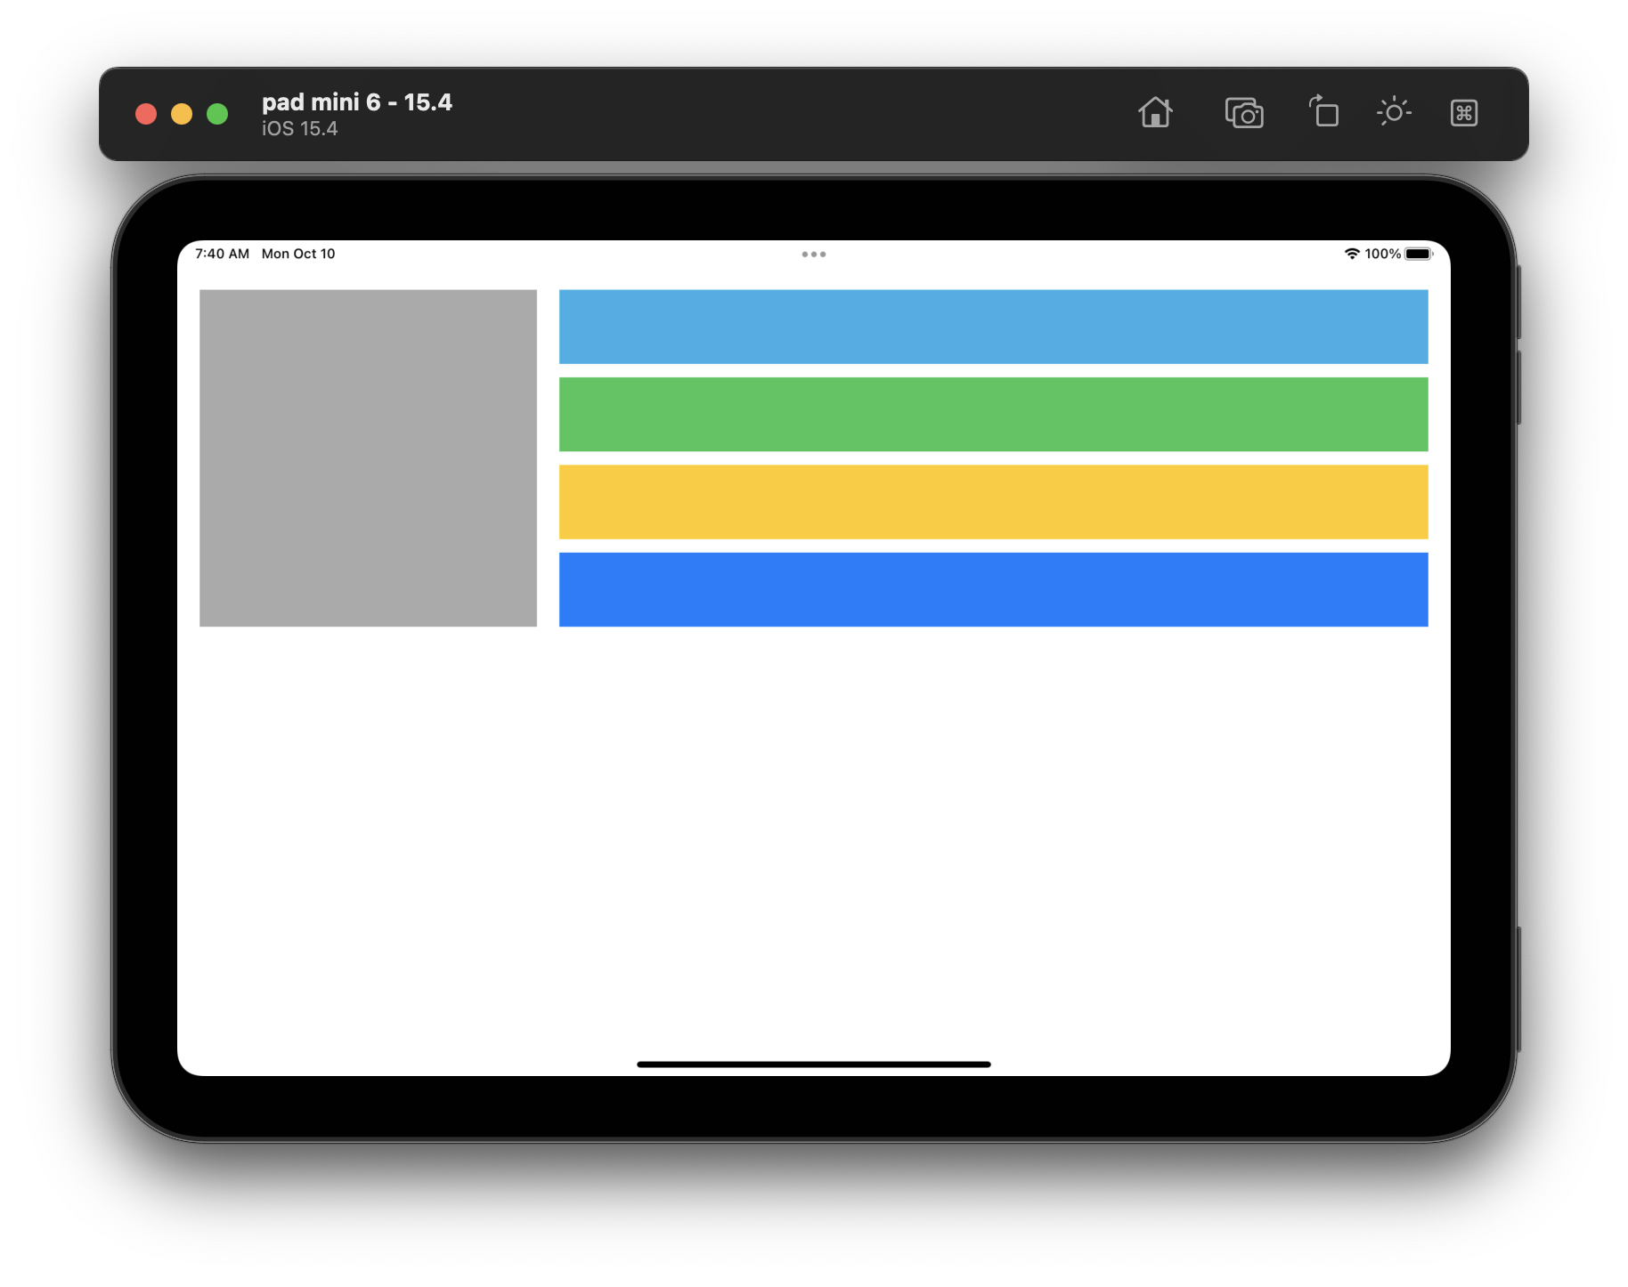
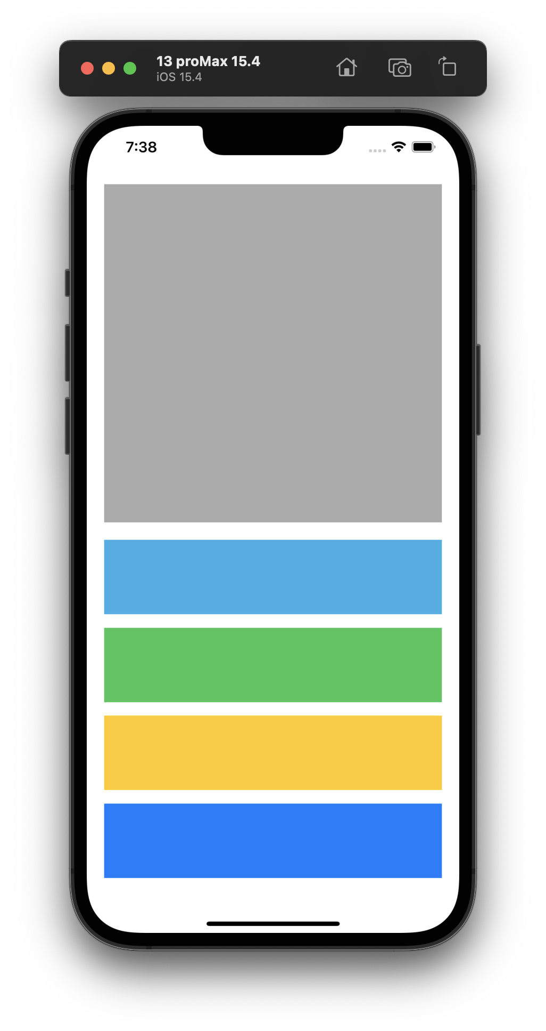
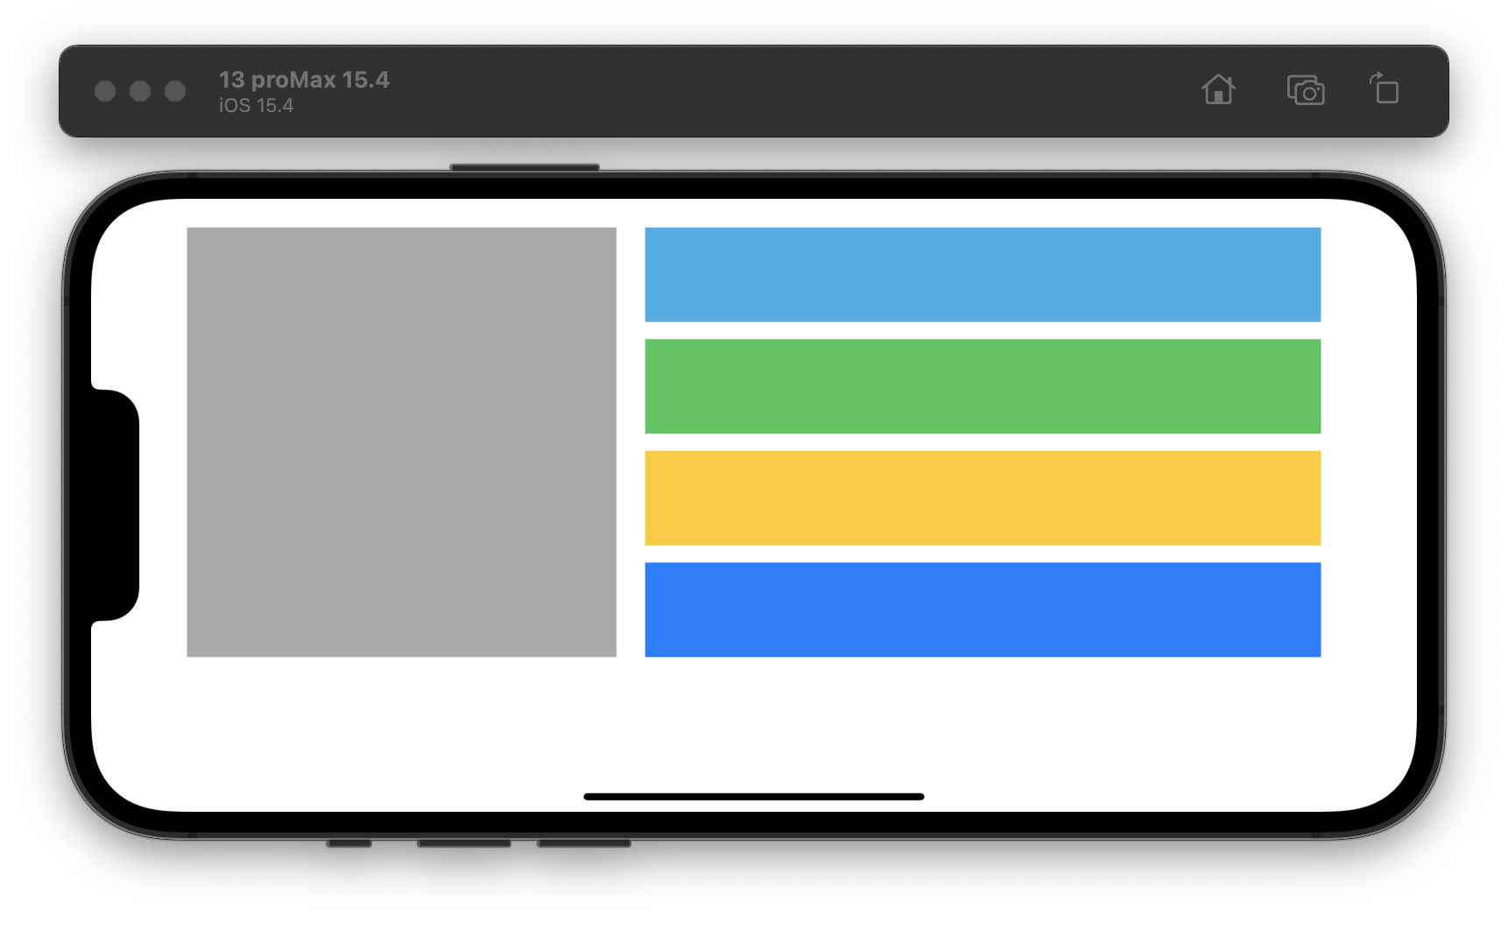
Thực hành #1
Width = 300pt
Sử dung: View, Constraint, Stack, Size Classes
Để thiết kế UI như design cho 3 size:
iPhone Portrait
iPhone Landscape
iPad Portrait, Landscape
Note:
stack chứa cyan, green, yellow, tint có chiều cao bằng gray
cyan, green, yellow, tint có chiều cao 22% stack.
20pt =
Full width
height = 22%
height = 22%
Width = 300pt
height = 22%

Slide 21
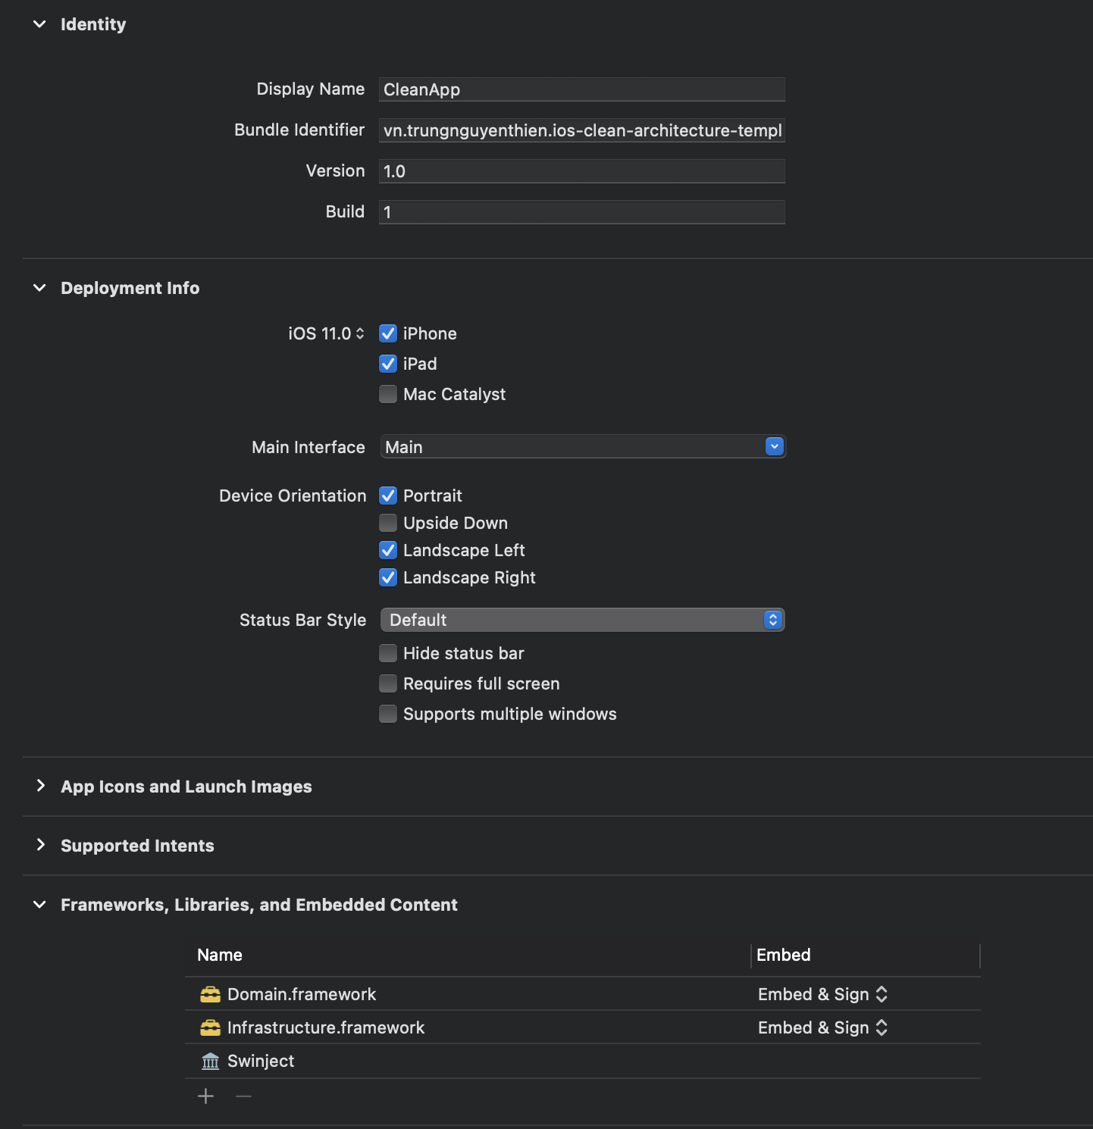
Common Setting General

Slide 22
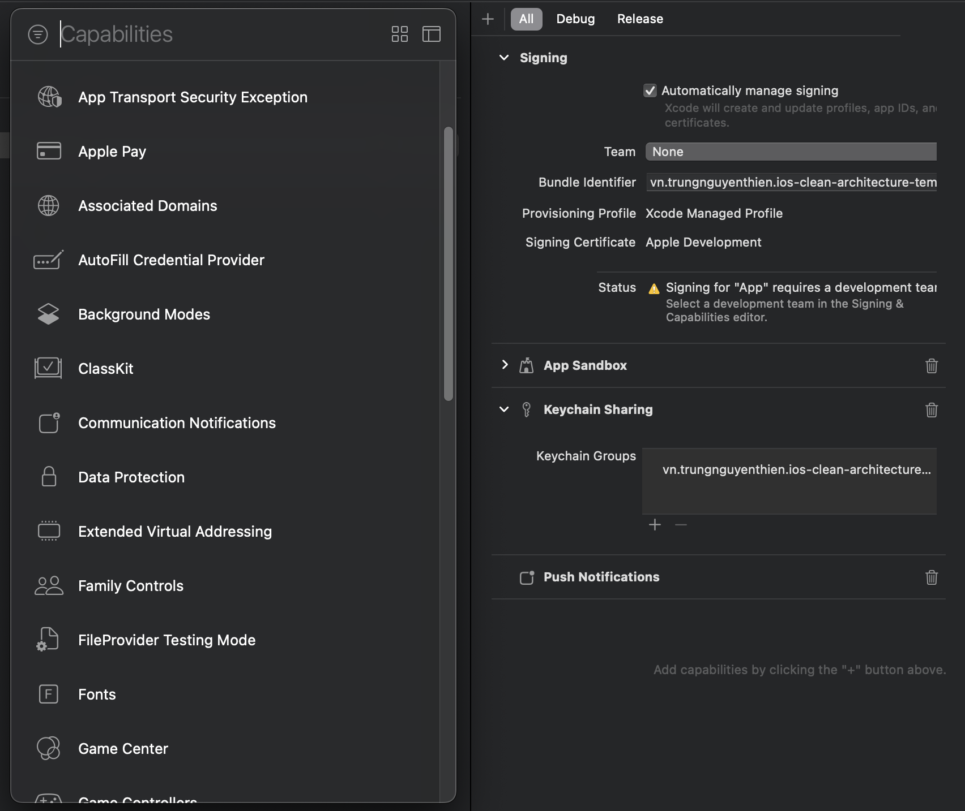
Common Setting Signing & Capabilities

Slide 23
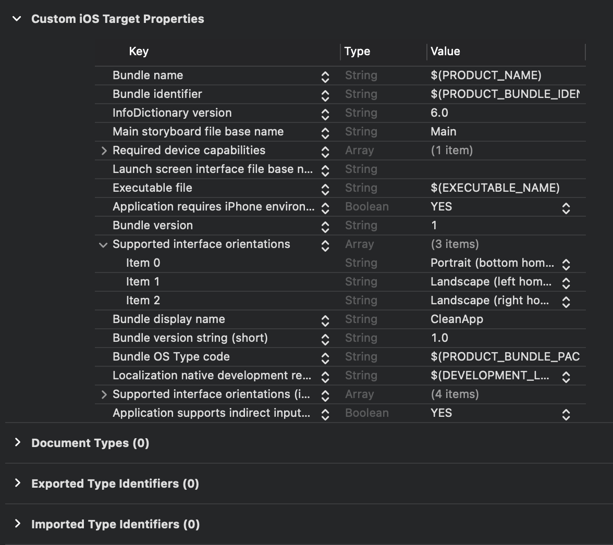
Common Setting Info

Slide 24
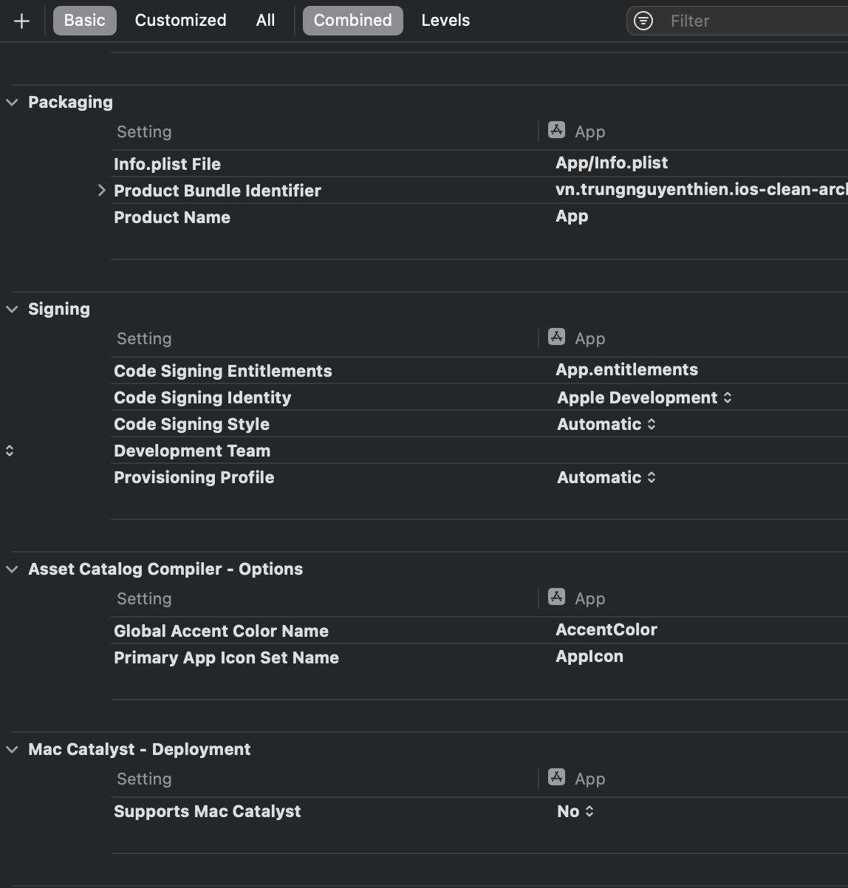
Common Setting Build Settings

Slide 25
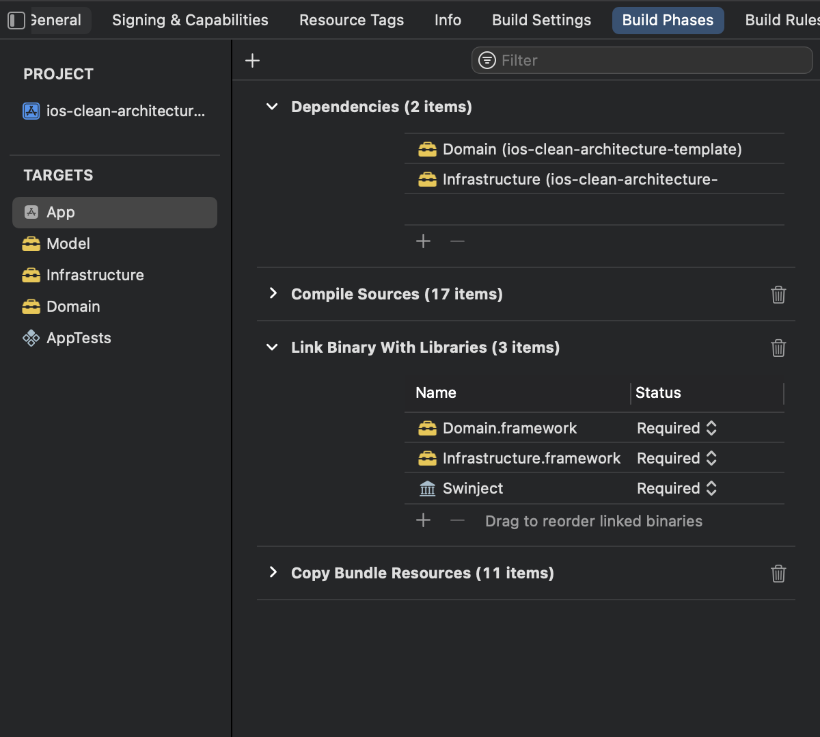
Common Setting Build Phases
1
Explicit Target Dependencies: Chỉ định các Target (khác) cần được build trước khi build Target này.
Source Swift của Target.
Chỉ định các library cần link.
Resource file (plist, xib, storyboard,
2
3
4
Notes:
Xcode Target Dependencies | Dmitry’s Blog (dnbespalov.com)

